Slide 1



Writing PowerShell
with VS Code
Rob Sewell @sqldbawithbeard https://sqldbawithAbeard.com

Slide 2
Speaker Questionnaire
Name : Rob
Occupation : DBA, Automator, Do-er, Trainer
Interests : PowerShell, Automation And SQL (PaaS geddit?)
Interesting Fact : Beard. (Still) Plays Cricket, Flies Drone
Speaker : SQL Saturdays, SQL Relay, PowerShell Events
Community : SQL South West , SQL Sat Exeter , PowerShell VG, PowerShell Conference EU Organiser, dbareports, dbatools, dbachecks, MVP

Slide 3
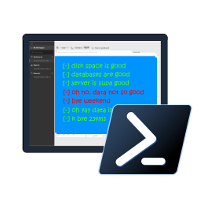






Contact Me
Quick Poll
@sqldbawithbeard
robsewellsqldba
sqldbawithAbeard.com
mrrobsewell@outlook.com
RobSewell.info

Slide 4
Which IDE to use?
IDE – Integrated Development Environment

Slide 5






PowerShell Code Editors
Notepad
Notepad ++
PowerShell ISE
Sapien PowerShell Studio
Visual Studio
Visual Studio Code

Slide 6
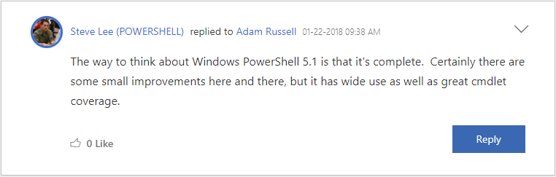
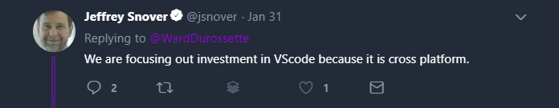
Why Not ISE?

Slide 7
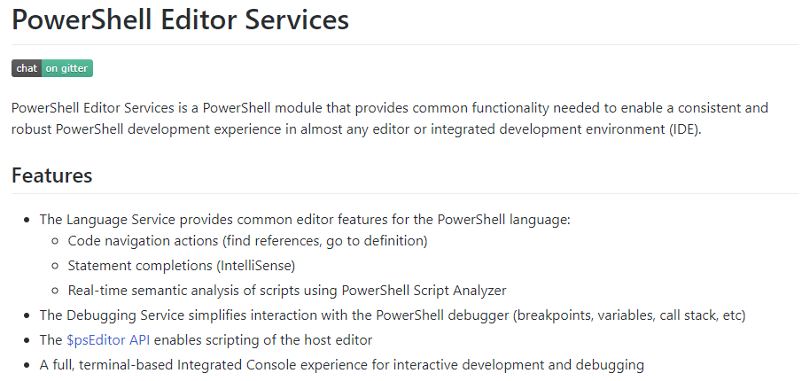
PowerShell Editor Services
powershell.github.io/PowerShellEditorServices/

Slide 8
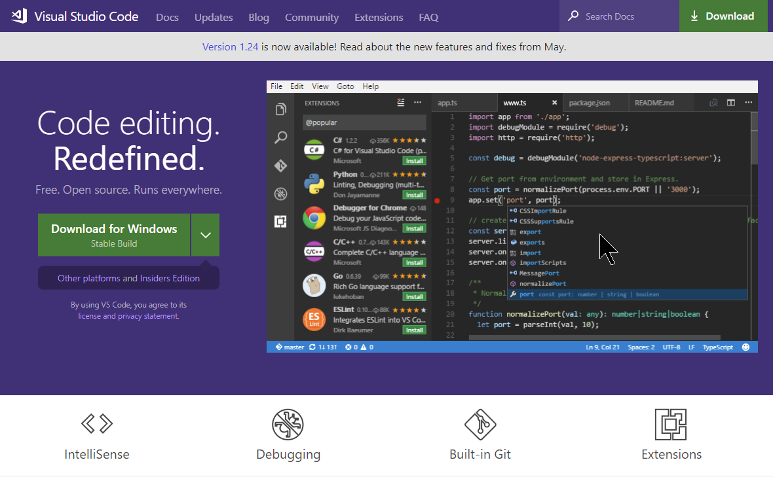
https://code.visualstudio.com/

Slide 9
















Sponsors
You Rock!
Gold
Silver
Bronze
Many thanks to our sponsors, without whom such an event would not be possible.

Slide 10
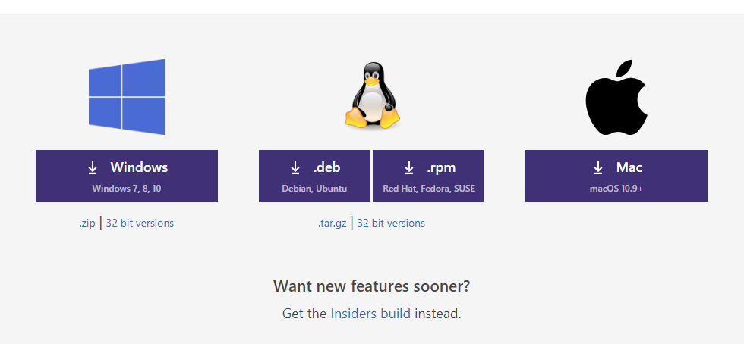
Multi-Platform
https://code.visualstudio.com/

Slide 11
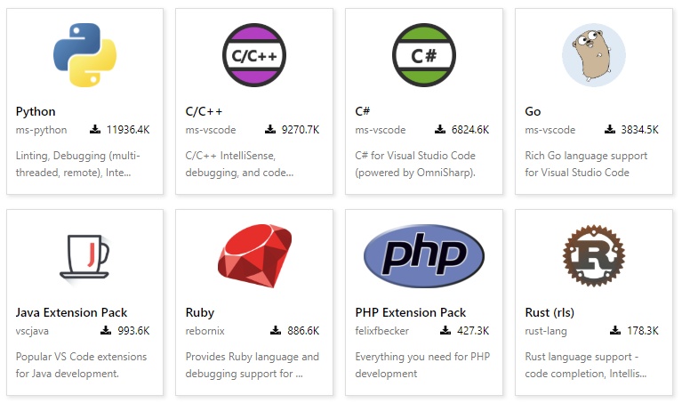
Multi-Language
https://code.visualstudio.com/

Slide 12
Multi-Language
Batch
C#
C++
Clojure
Coffee Script
CSS
Dockerfile
F#
Go
Groovy
Jade
Java
JavaScript
JSON
HandleBars
HTML
Ini
Less
Lua
Makefile
Markdown
Objective-C
Perl
PHP
PowerShell
Python
R
Razor
Ruby
Rust
Sass
SQL
Swift
TypeScript
Visual Basic
XML

Slide 13
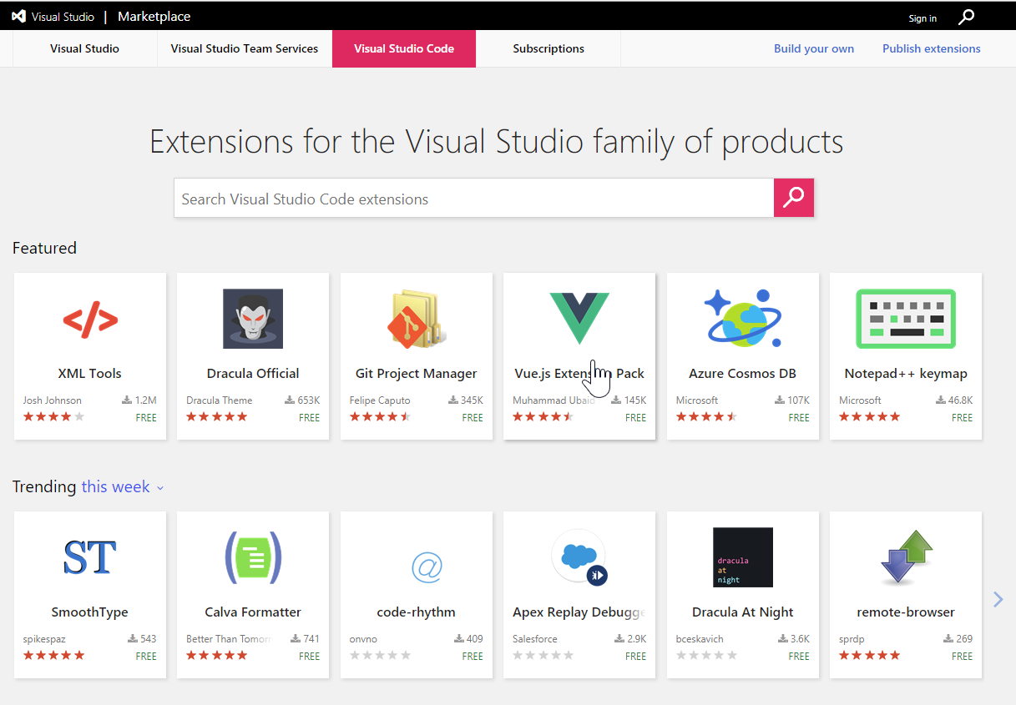
marketplace.visualstudio.com/vscode

Slide 14
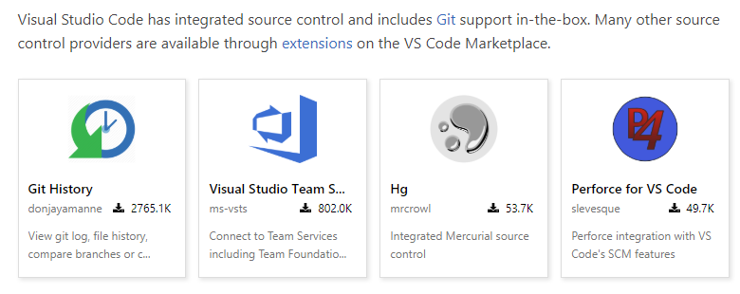
Multiple Source Control

Slide 15
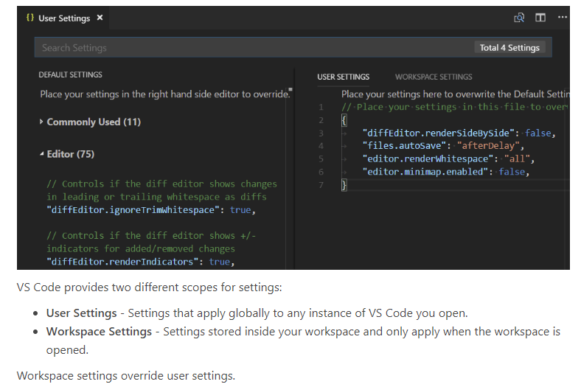
Configurable

Slide 16
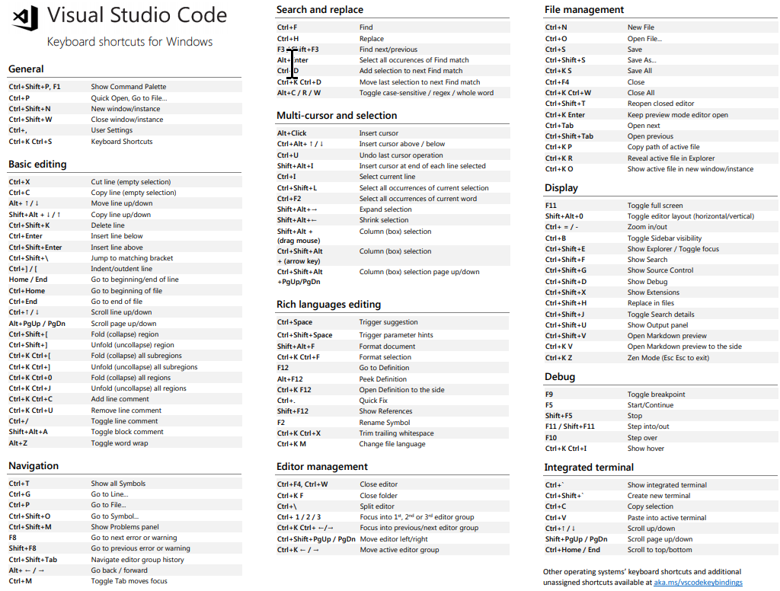
Keyboard Shortcuts
code.visualstudio.com/docs/getstarted/keybindings

Slide 17
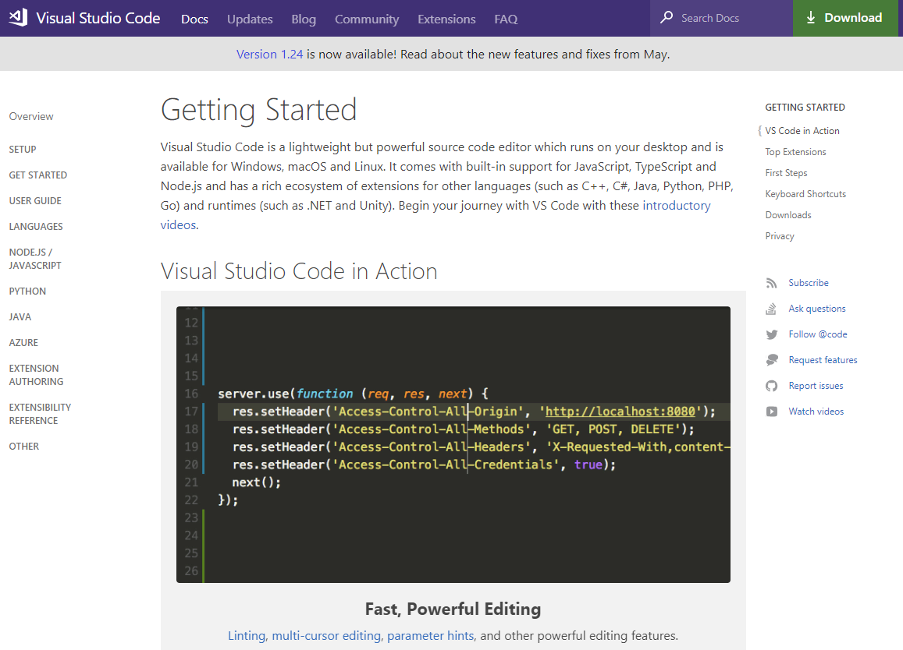
Get-Help
Did I Mention FREE?
code.visualstudio.com/docs/

Slide 18

Thank you
For the Venue & Catering

Slide 19
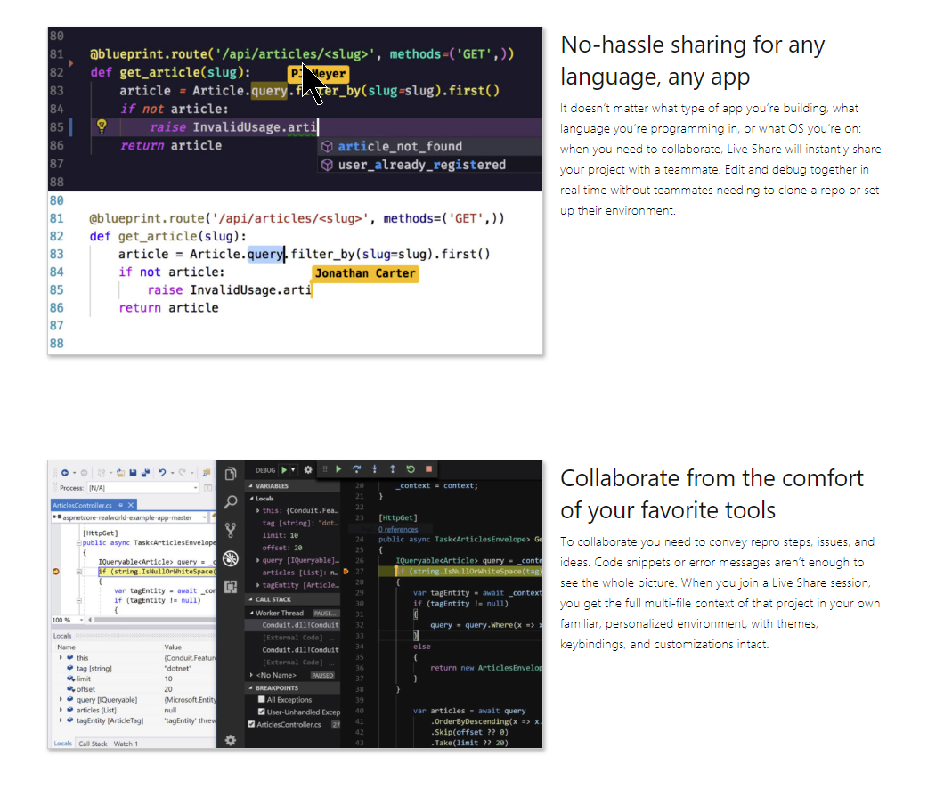
Collaboration
code.visualstudio.com/docs/
https://visualstudio.microsoft.com/services/live-share/

Slide 20
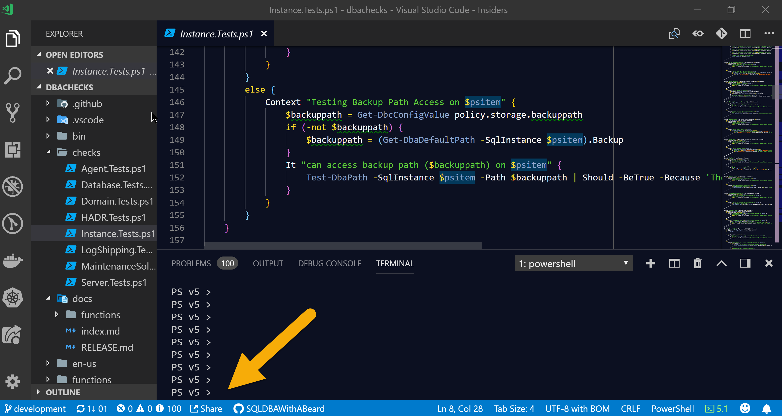
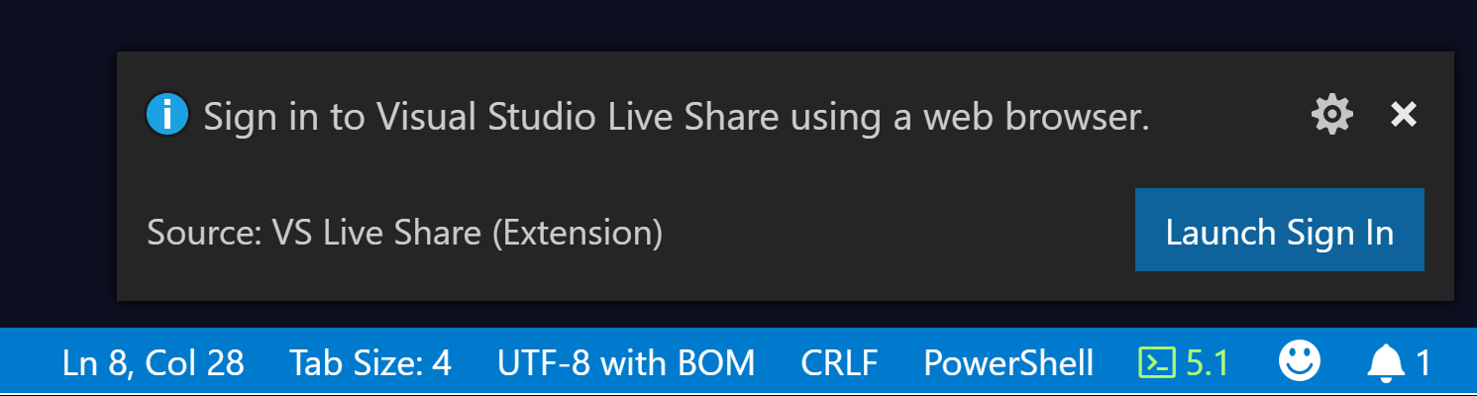
Collaboration – Local Machine
code.visualstudio.com/docs/

Slide 21
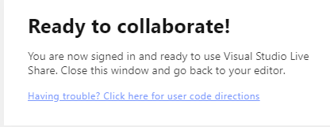
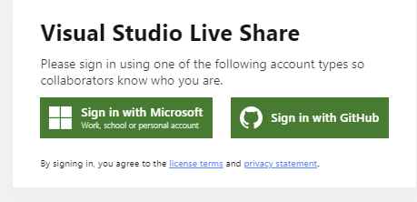
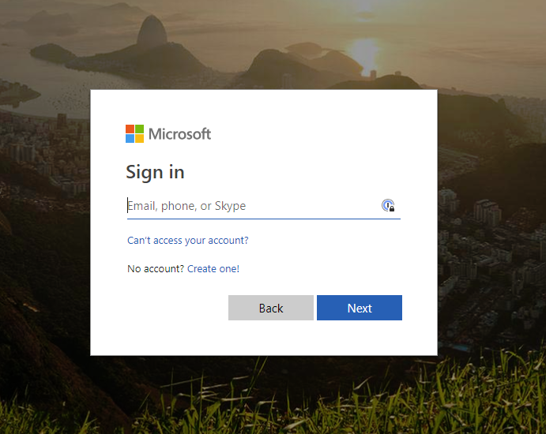
Collaboration – Local Machine
code.visualstudio.com/docs/

Slide 22
Collaboration – Local Machine
code.visualstudio.com/docs/

Slide 23
Collaboration – Local Machine
code.visualstudio.com/docs/

Slide 24
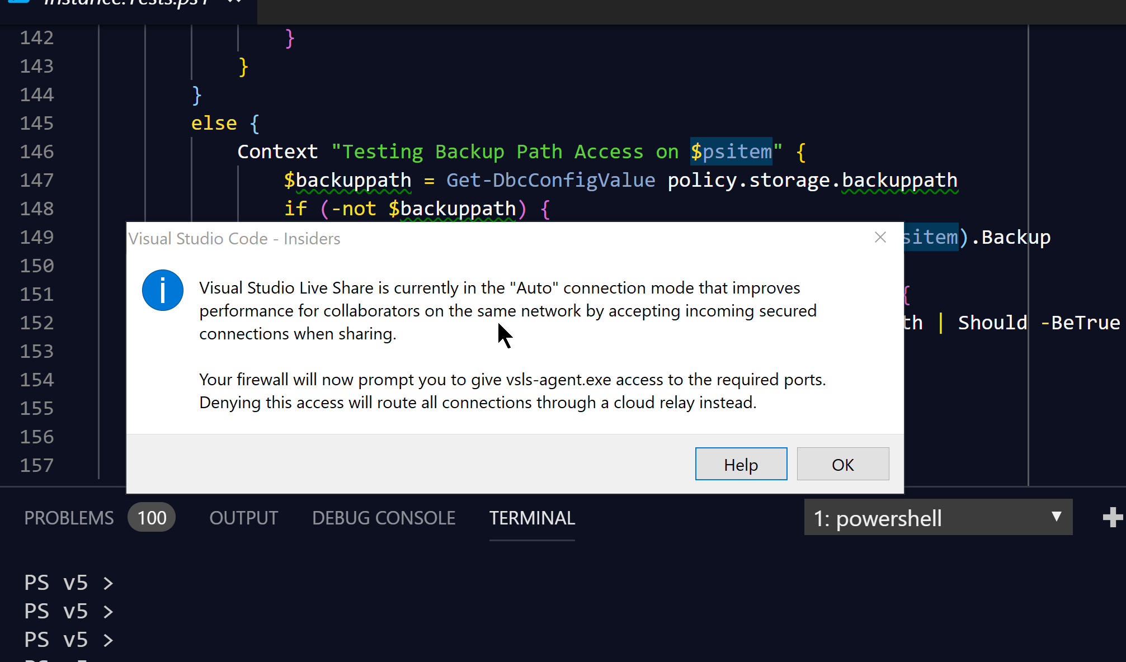
Collaboration – Local Machine
code.visualstudio.com/docs/

Slide 25
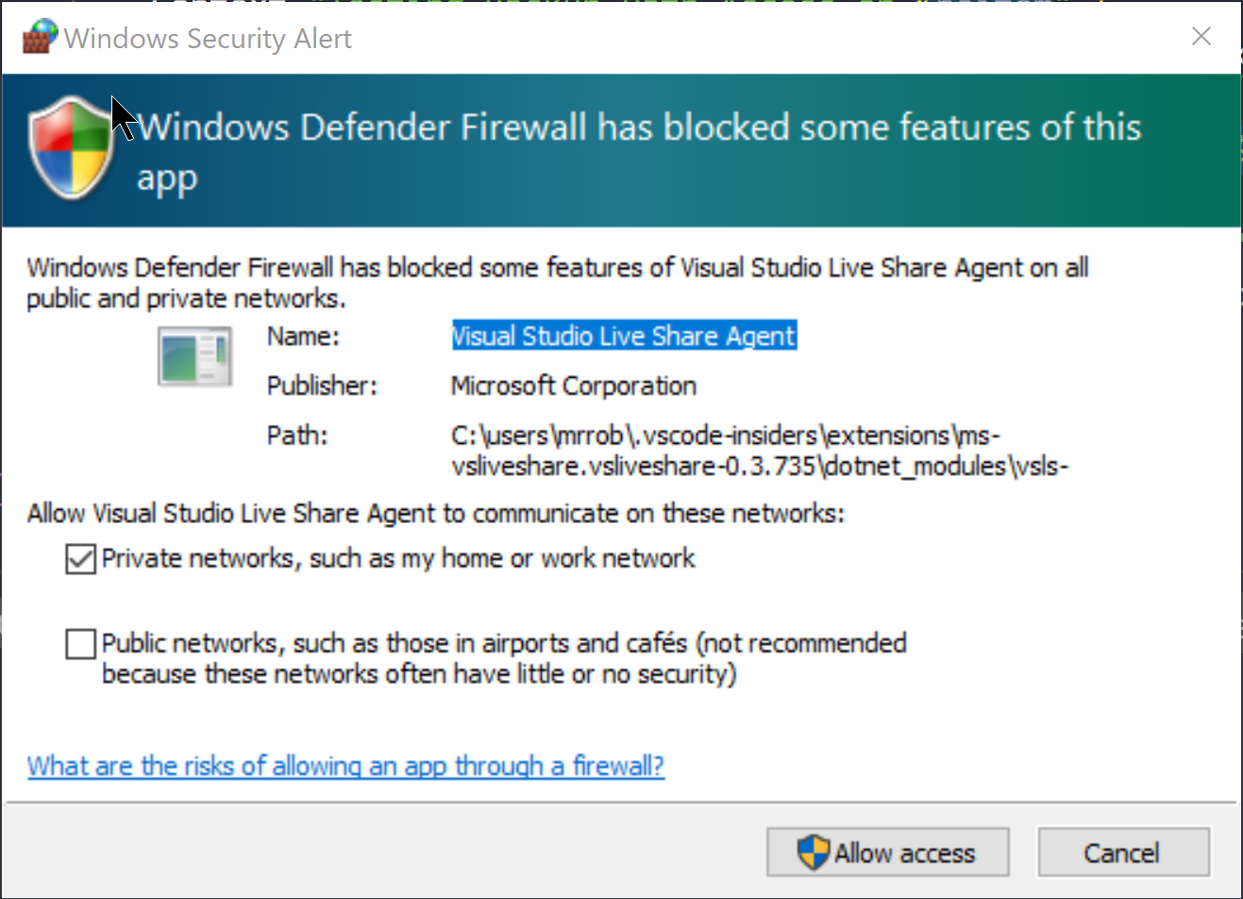
Collaboration – Local Machine
code.visualstudio.com/docs/

Slide 26
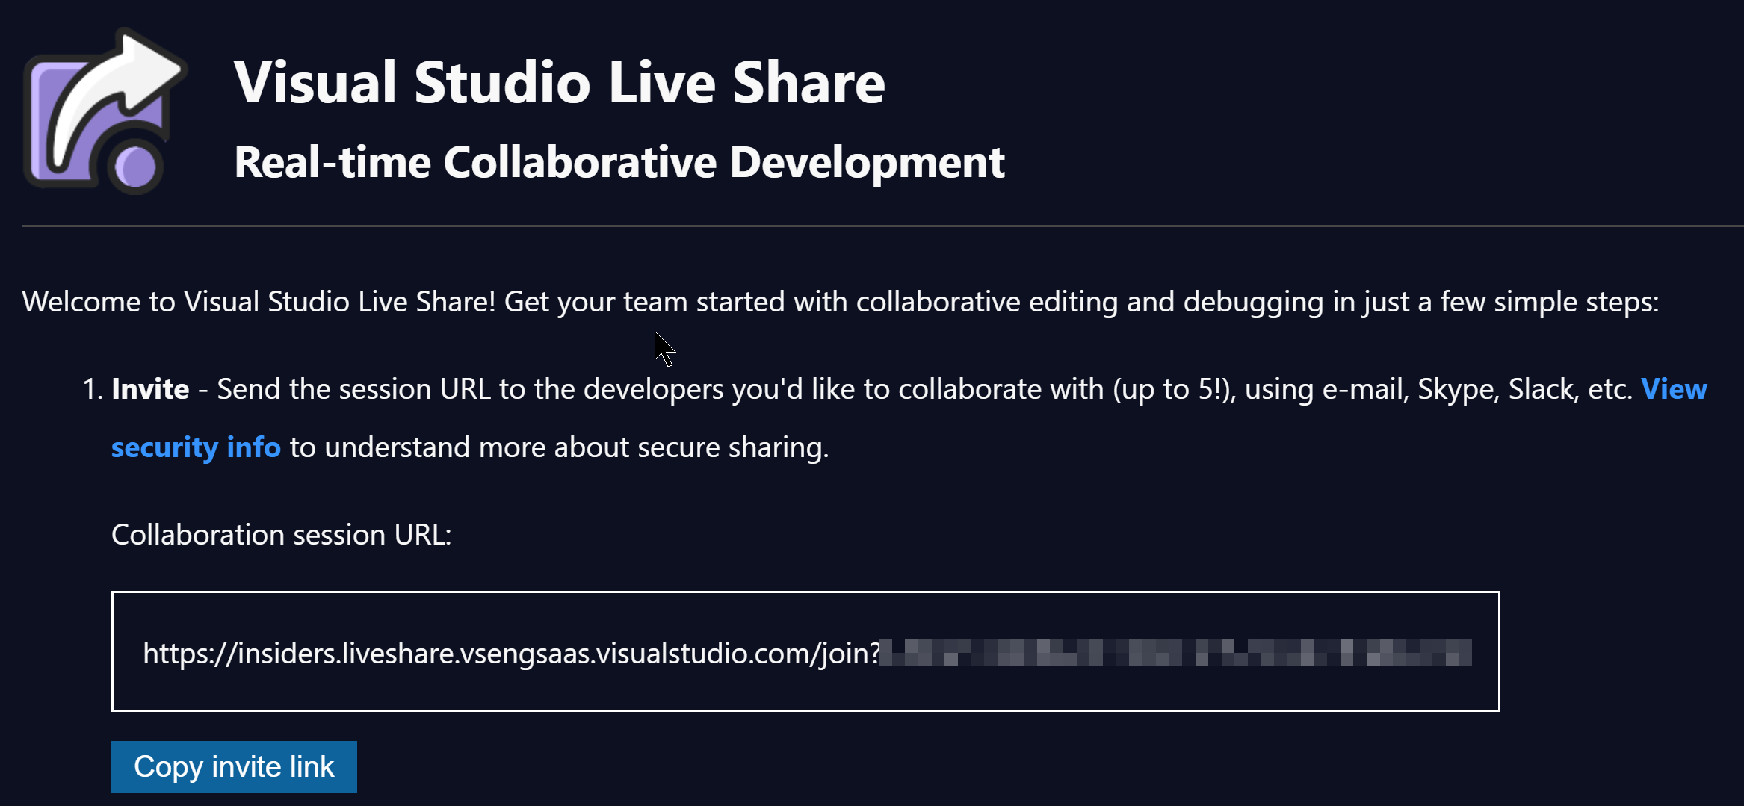
Collaboration – Local Machine
code.visualstudio.com/docs/

Slide 27
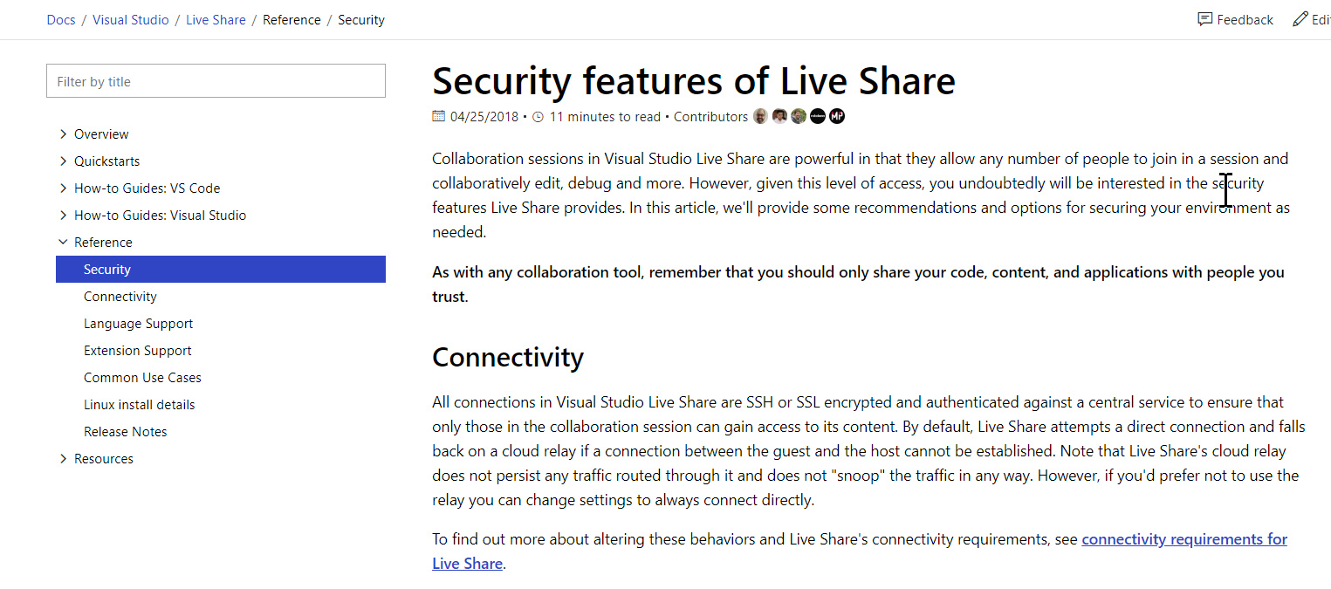
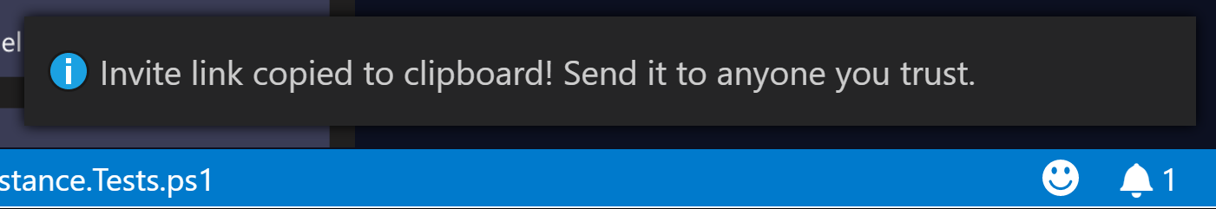
Collaboration – Local Machine
code.visualstudio.com/docs/

Slide 28
Collaboration – Local Machine
https://docs.microsoft.com/en-us/visualstudio/liveshare/reference/security

Slide 29
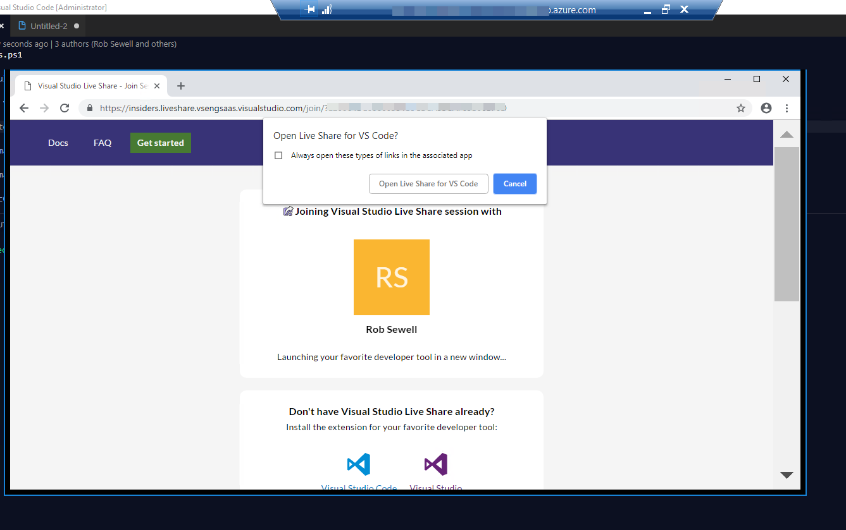
Collaboration – Local Machine
code.visualstudio.com/docs/

Slide 30
Collaboration – Remote Machine
code.visualstudio.com/docs/

Slide 31
Collaboration – Remote Machine
code.visualstudio.com/docs/

Slide 32
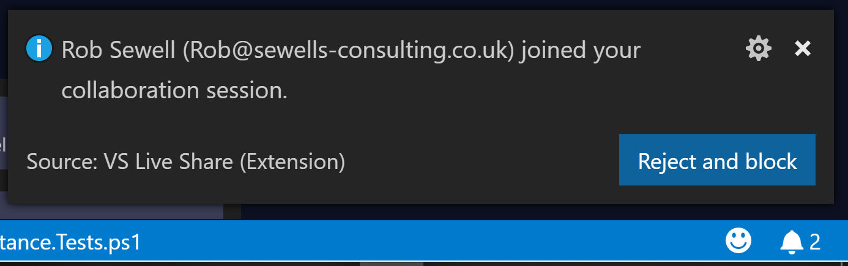
Collaboration – Remote Machine
code.visualstudio.com/docs/

Slide 33
Collaboration – Local Machine
code.visualstudio.com/docs/

Slide 34
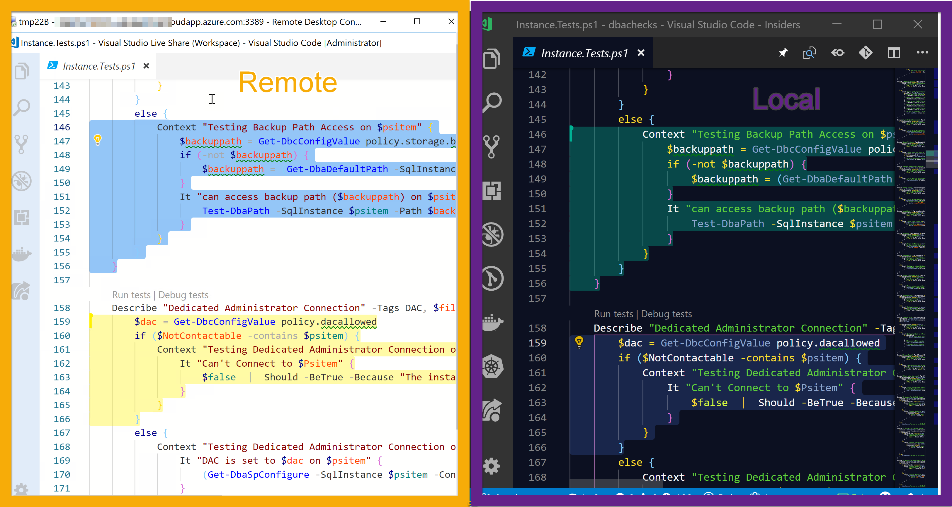

Slide 35
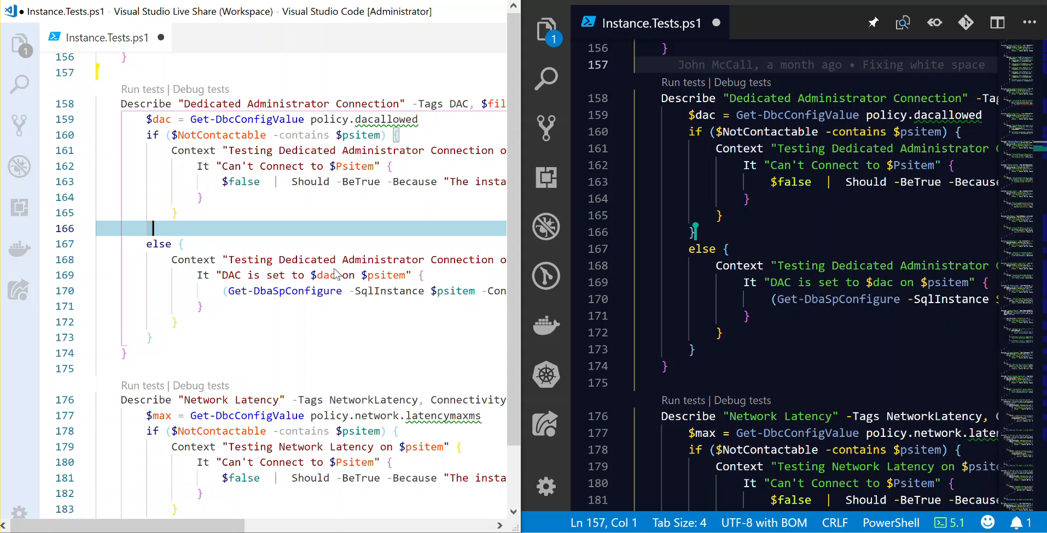

Slide 36
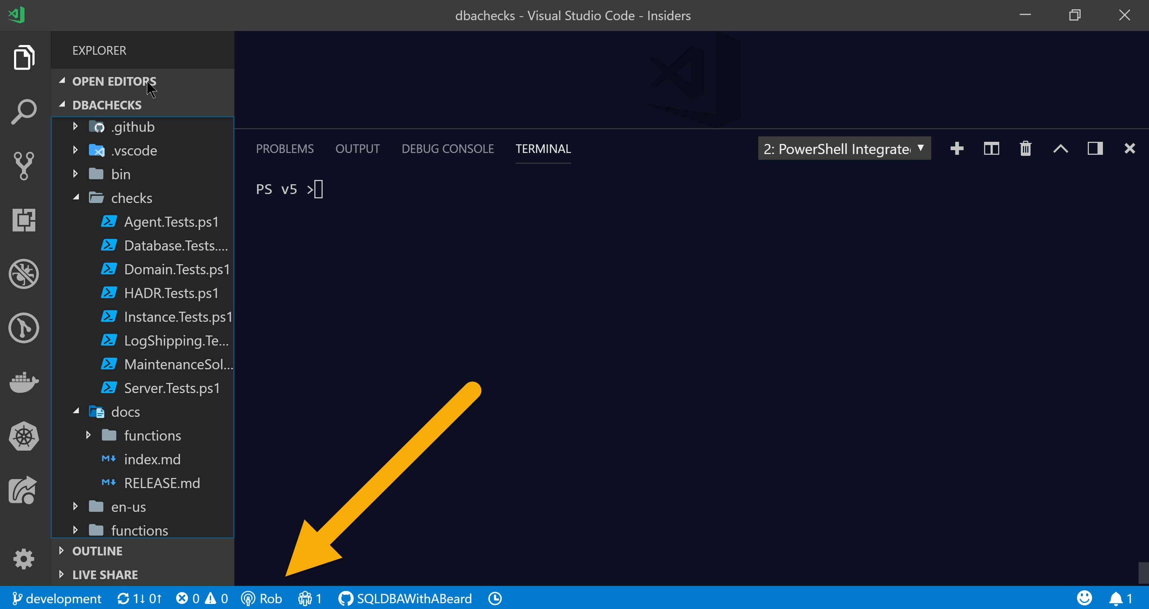
Collaboration
But not just the code
You can share your Terminal too !
code.visualstudio.com/docs/

Slide 37
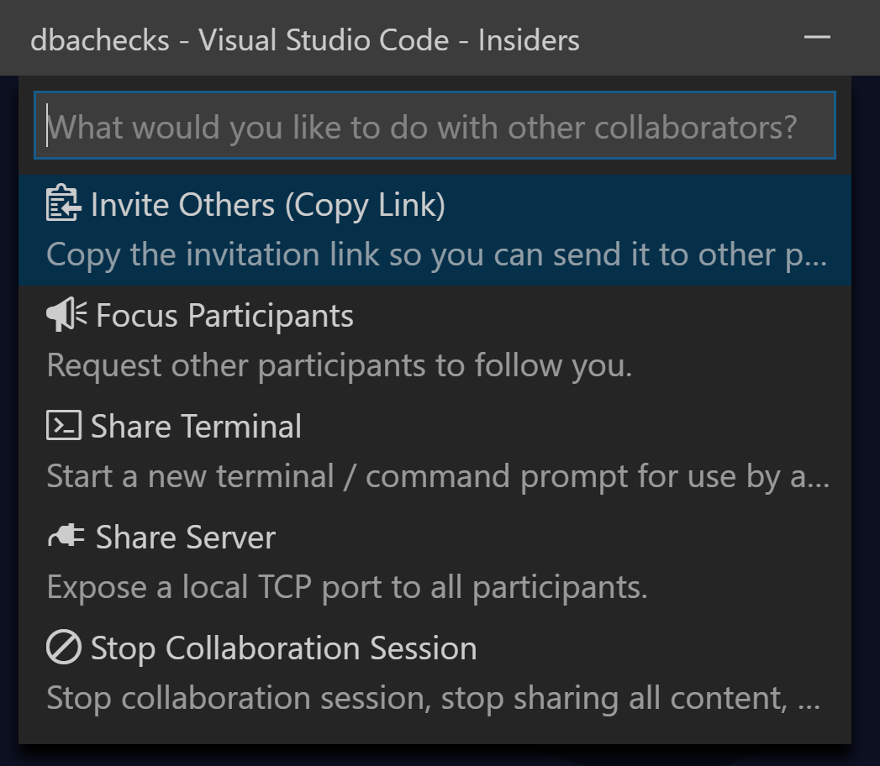
Collaboration – Local Machine
code.visualstudio.com/docs/

Slide 38
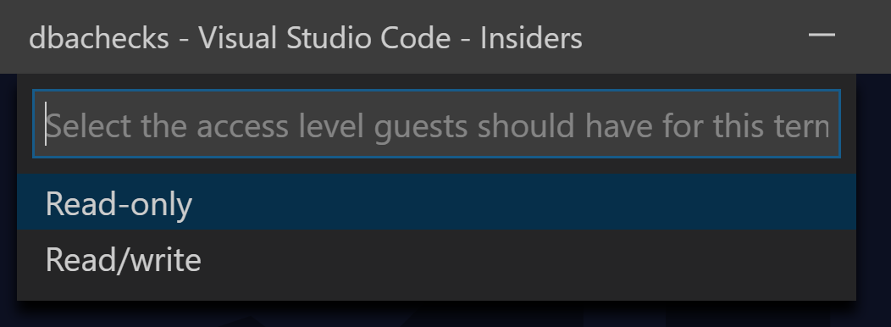
Collaboration – Local Machine
code.visualstudio.com/docs/

Slide 39
Collaboration – Local Machine
code.visualstudio.com/docs/

Slide 40
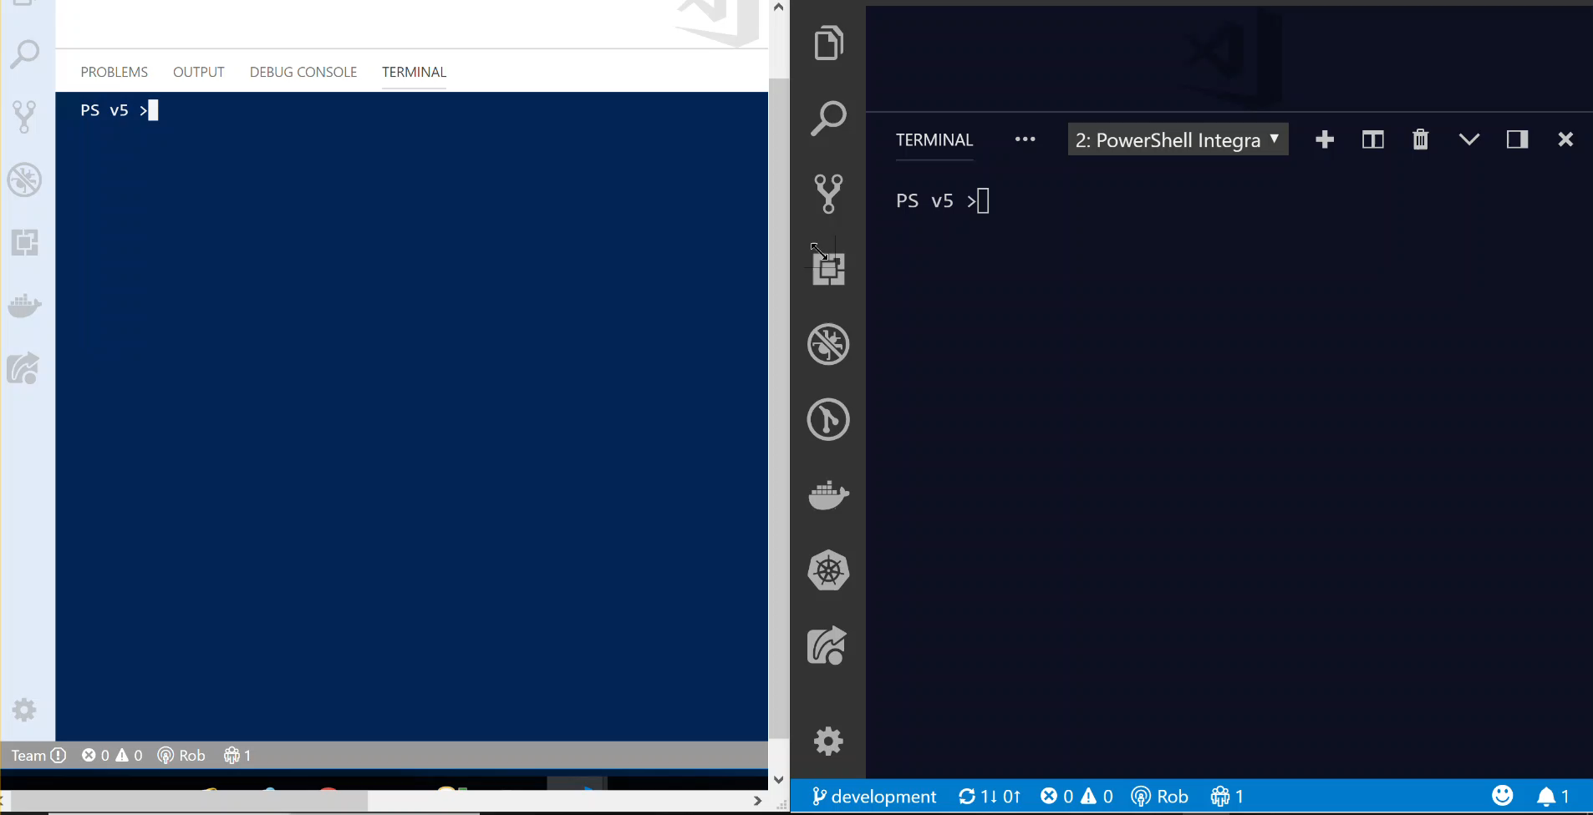

Slide 41

Hey Beardy !
MUST BE TIME FOR A DEMO

Slide 42
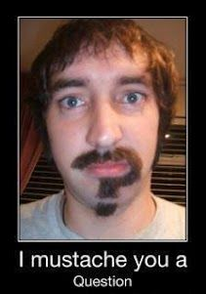
Questions?
?
?
?
?
?
?
?
?
?
?
?
?
?
?
?
?
Rob Sewell @sqldbawithbeard sqldbawithAbeard.com

Slide 43

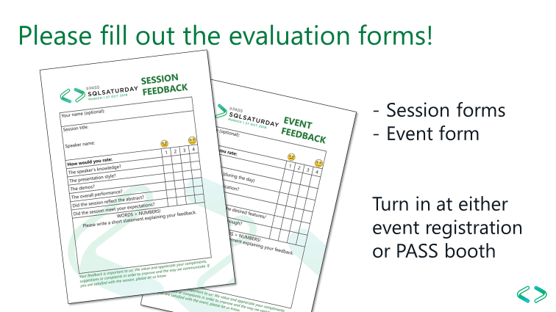
Just like Jimi Hendrix …
We love to get feedback
Please complete the
session feedback forms

Slide 44
Rob Sewell @sqldbawithbeard sqldbawithAbeard.com
Just like Jimi Hendrix …
We love to get feedback
Please complete the
session feedback forms

